Slide 1
Automate processes with Robotic Process Automation and Power Automate for desktop

Slide 2
Module Agenda
Build your first Power Automate for desktop flow
Define input and output parameters in Power Automate
Integrate desktop flows with Outlook connector in Power Automate for desktop
Connect a cloud flow to desktop flows in Power Automate for desktop
Use AI Builder to process invoice forms in Power Automate
Use the Teams connector in Power Automate
Run a Power Automate for desktop flow in unattended mode
Optimize your business process with process advisor

Slide 3
Lesson 1:Build your first Power Automate for desktop flow

Slide 4
Introduction
In this module, you will:
Learn about Power Automate flows.
Create a new desktop flow.
Record actions that are performed in a desktop-based application.
Perform a test run of the new desktop flow.

Slide 5
Set up the environment
The following are the steps to set up the environment.
Create a trial environment with database:
Go to Microsoft Power Platform Administration Center to create environment.
Software installation:
Download and install Power Automate, required extensions and Contoso Invoicing application.
Contoso Invoicing app:
You will use an invoicing application to explore the concepts and actions that are available to you in desktop flows.

Slide 6
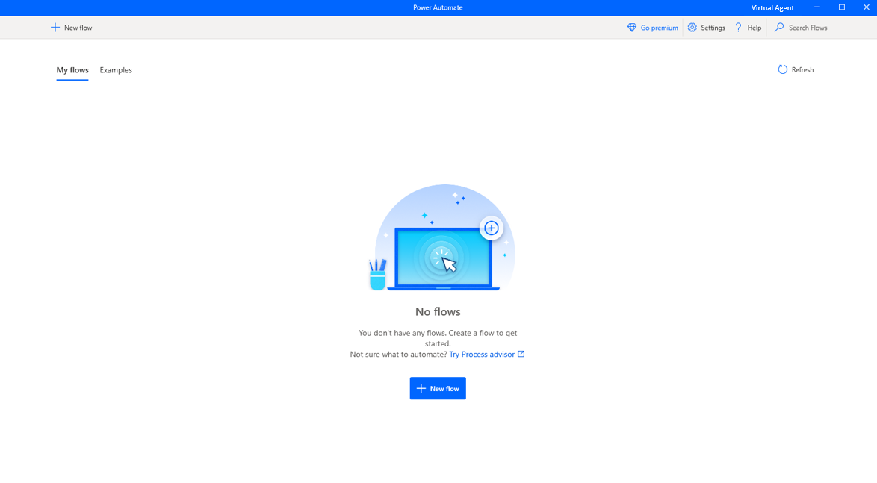
Explore Power Automate for desktop（1/2）
Open and explore Power Automate:
Under Flows, you will see existing desktop flows that you have, and you will be able to edit, start, or delete them.
On the right is a screen shot showing the Power Automate page with New flow button.
You can explore what creating or editing a flow looks like by selecting the + New flow button in the upper-left corner.

Slide 7
Explore Power Automate for desktop（2/2）
The designer contains several elements for you to focus on:
The toolbar (A)
Subflows (B)
Actions pane (C)
Workspace (D)
Input/output variables (E)
Flow variables (F)

Slide 8
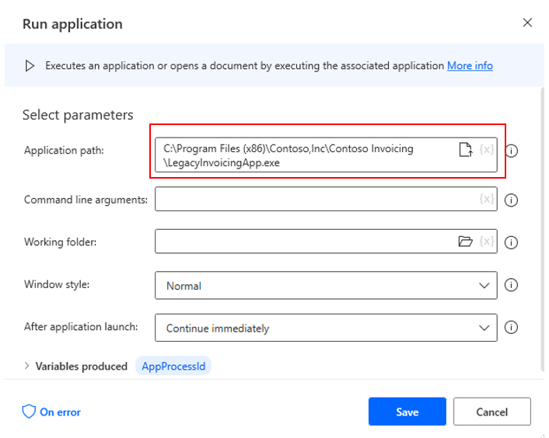
Create your first Power Automate for desktop flow
You have to train the flow by adding those actions:
To add actions to your flow, select the desired action and then drag it to the Main canvas.
In the following dialog box, specify the path to the application by entering the location manually
Leave the remaining fields as they are and then select Save.

Slide 9
Record Power Automate for desktop actions
The following are the steps to record Power Automate for desktop actions:
To begin recording your desktop actions, open the Contoso Invoicing app and the Desktop recorder in Power Automate. Select the Start recording button in Power Automate.
As you record, make sure that you go slowly and wait several seconds between actions.
In the Contoso Invoicing app, select Invoices and then create a new record by selecting the appropriate icon in the upper left.
When you're finished, select the Save icon to save your record.
Return to the recording, put it in Power Automate, and then select Finish.

Slide 10
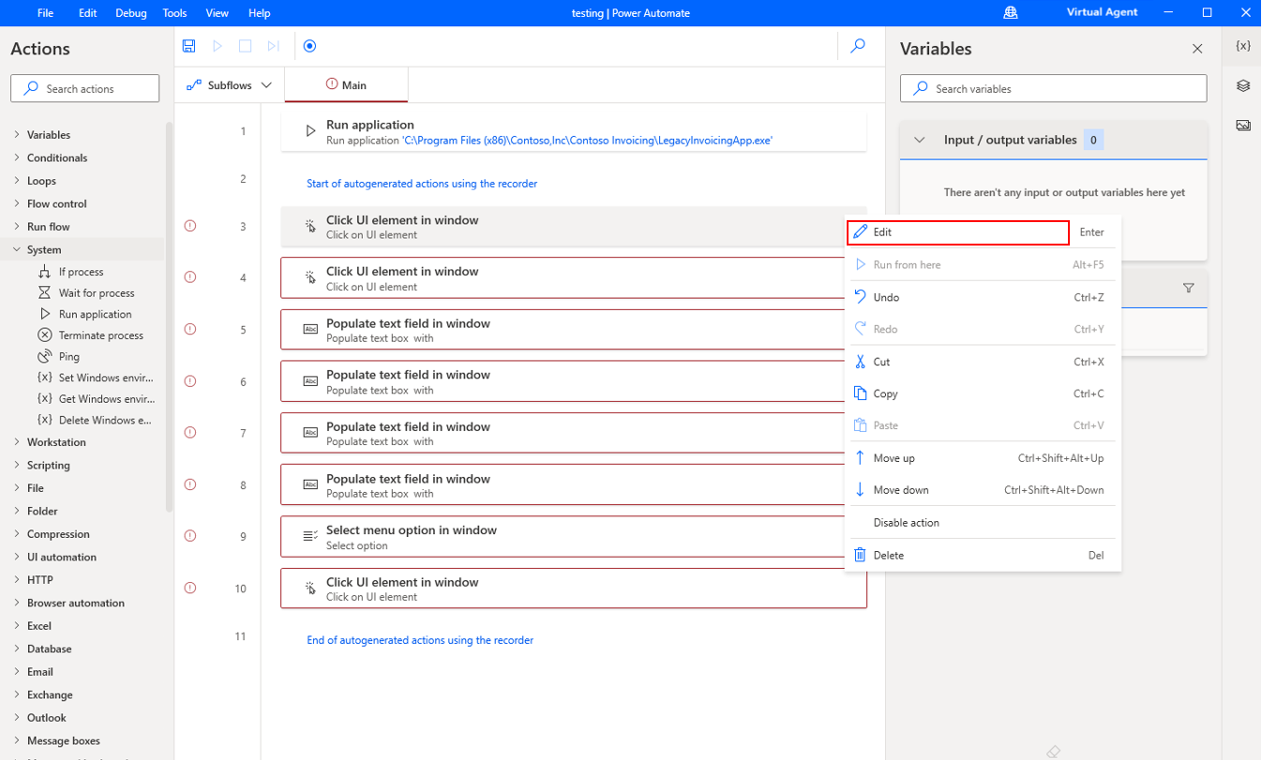
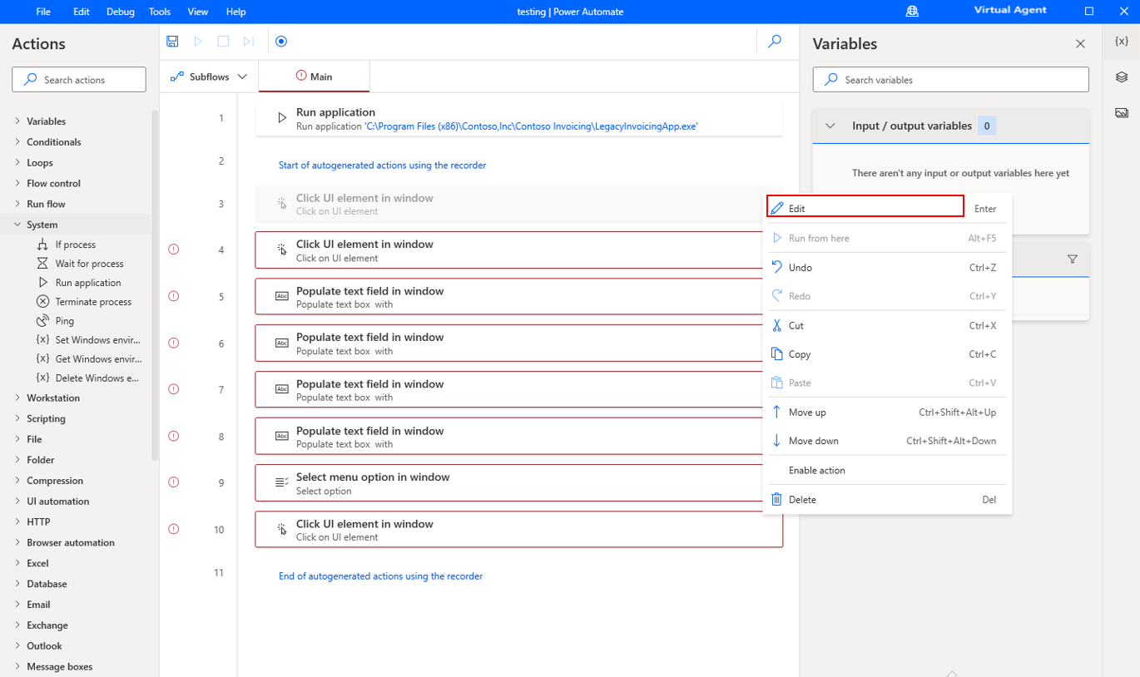
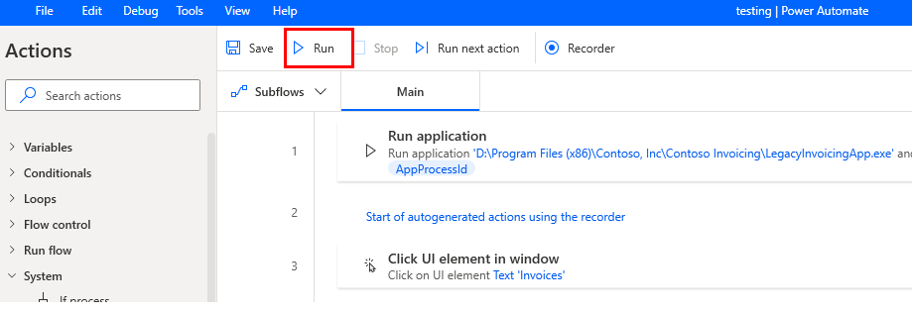
Edit and test recorded actions
Screenshot of the edit feature in the ellipsis menu. You can edit the recording actions by selecting the ellipsis (...) button and then by selecting Edit.
Screenshot of the Delete feature in the ellipsis menu.
Screenshot of Run test feature from the toolbar. Test your flow by selecting the Run icon in the toolbar. Avoid using your computer to perform actions while the test is running.

Slide 11
Check your knowledge
What indications do you have that your actions are recording appropriately?
Can this operation of recording keyboard shortcuts that are used for navigation be performed in Power Automate designer?
Other than recording, how do you add actions to your flow?

Slide 12
Summary
In this module, you have:
Learned about the Power Automate flows.
Created a new desktop flow.
Recorded actions that are performed in a desktop-based application.
Performed a test run of the new desktop flow.
Notes:
Key takeaways
Key takeaways of this module include:
Desktop flows allow you to create custom automations without a pre-existing connector.
Recording your actions is as simple as pressing a button.
RPA is accessible to anyone who uses the Power Automate application.

Slide 13
Lesson 2:Define input and output parameters in Power Automate

Slide 14
Introduction
In this module, you will:
Create a desktop flow with predefined inputs.
Record actions that are done in the desktop-based Contoso Invoicing application by using these inputs and capturing application data for output.
Do a test run of a new desktop flow with a new set of inputs.

Slide 15
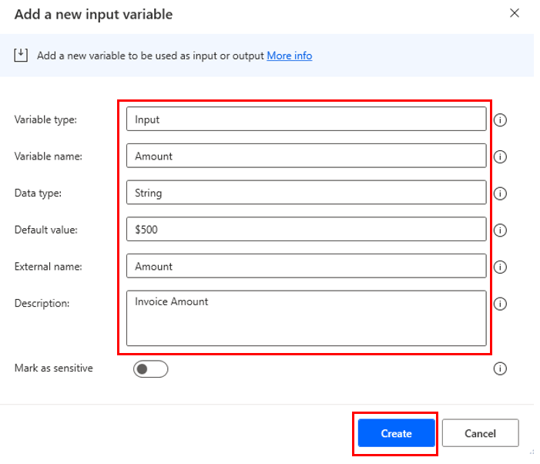
Define an input variable
Several steps to define an input variable:
Begin in your Power Automate for desktop app and then open the designer by editing a desktop flow.
When you're in the designer, select the plus (+) icon under the Input/output variables section and then select Input.
You can set your own values for your variable, or you can use those that are displayed in the following screenshot. Select Create to finish your variable.

Slide 16
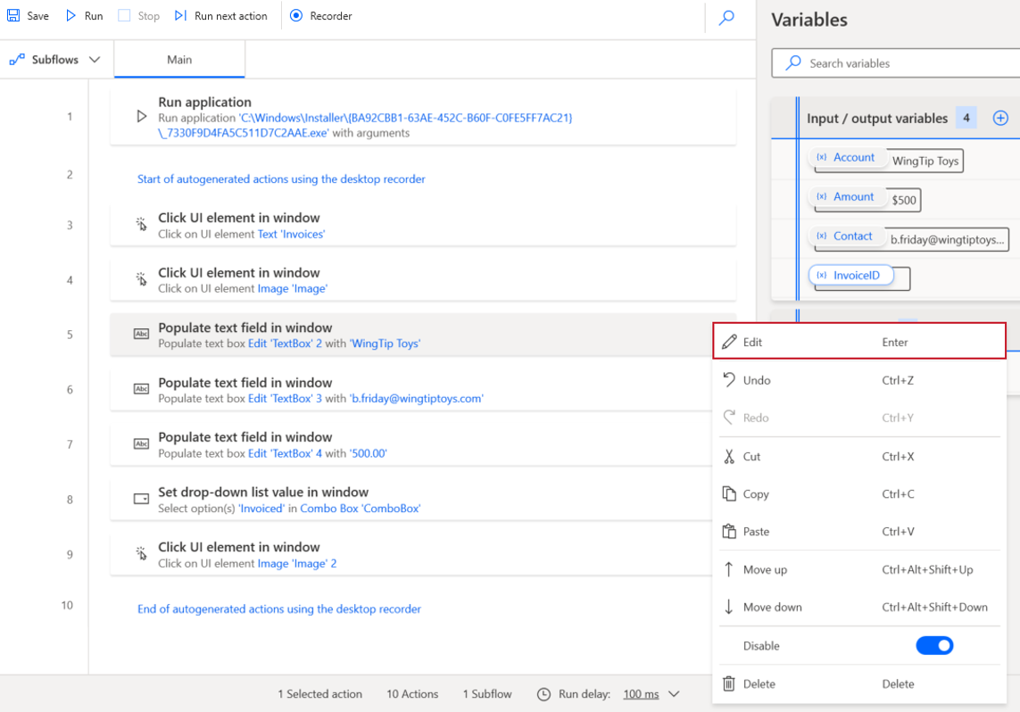
Set input variables
Several steps to set input variables:
If you‘re using the desktop flow that was created by using the Contoso Invoicing app, the first step that requires a variable is step 5. Select the ellipsis (...) to the right of the step and then select Edit, as shown on the right.
Delete the value in Text to fill-in: and then select {x}.
Double-click the variable, which in this case is Account.
Select Save to close the dialog box and complete your variable setup.

Slide 17
Define output variables(1/2)
The main difference between input and output variables:
Input variables are defined before the flow runs and have a default value in case they aren't defined.
Contrarily, output variables are defined along the process of the flow.

Slide 18
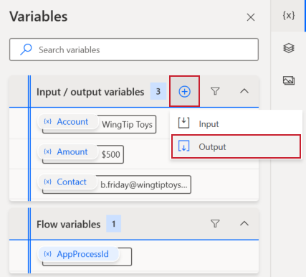
Define output variables(2/2)
Several steps to define output variables:
To define an output variable, select the plus (+) icon beside the Input/output variables section and then select Output, as shown on the right.
Fewer parameters are required for you to define as part of an output variable.

Slide 19
Add UI elements and test
How to add UI elements and test:
On the Actions Pane, expand UI automation and Data extraction. Select and drag Get details of a UI element in window to the appropriate step in your flow.
In the next dialog box, select the down arrow to expand options and then select Add a new UI element.
The tracking session is looking for you to select an element to capture. To choose the element, hover over it until you see a red border, hold down the Ctrl key, and then select the element to record it in the tracking session.
When the selected element displays in the Tracking session window, select Done.
The Tracking session window will disappear, leaving the Power Automate designer and the edit dialog box for the Get details of a UI element in window dialog box. Select Save.

Slide 20
Check your knowledge
Which statement correctly identifies when input and output variables are defined?
Which entity will request a default value when it is defined?
What is the data type option of the input variable?

Slide 21
Summary
After having reviewed this module, you should be able to:
Create a desktop flow with predefined inputs.
Record actions that are performed in the desktop-based Contoso Invoicing application by using these inputs and capturing application data for output.
Perform a test run of a new desktop flow with a new set of inputs.
Notes:
Key takeaways
The key takeaways for this module are:
Input variables allow you to feed information into your desktop flow.
Output variables allow you to collect information from within your desktop flow to use later.
Adding UI elements and setting variables will create exponential value for your desktop flows.

Slide 22
Lesson 3:Integrate desktop flows with Outlook connector in Power Automate for desktop

Slide 23
Introduction
In this module, you will:
Create a new solution to package the complete invoice processing solution.
Create a new cloud flow that initiates the invoicing process through the receipt of an email.
Integrate an invoicing desktop flow into a new cloud flow.
Test the new cloud flow.

Slide 24
Build a cloud flow that is triggered in Outlook
How to build a cloud flow that is triggered in Outlook:
Go to powerautomate.microsoft.com to get started, select Solutions on the left navigation menu, and then select New solution.
Set the display name for your solution and set the publisher as CDS Default Publisher and then select Create.
After you have selected create, the Solutions screen will populate with your new solution. Select the name (in this case Invoice processing solution) to open it.
This screen is where you will create and edit flows that are specific to this solution. To create a new solution-aware flow, select Cloud flows, Automation, Cloud flow then Automated.
Name your flow. The following flow has been named Use Outlook email to trigger a Desktop flow, but you can choose whatever name you want. Search the actions to find When a new email arrives (V3). Click on Create.
You may need to wait for Outlook to log in, configure gateway connection, etc.

Slide 25
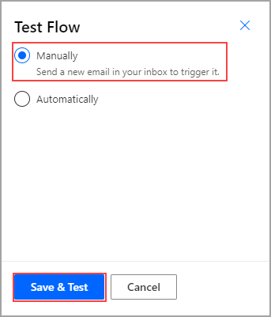
Test your new flow
Several steps to test your new flow:
Select Test in the upper-right corner of the screen and then select Manually > Save & Test, as shown on the right.
Open the Power Automate for desktop application and send yourself an email.

Slide 26
Check your knowledge
When you are given multiple versions of actions within Power Automate, which version should you typically select?
What is a solution in Power Automate?
Can you create and edit flows by using Outlook?

Slide 27
Summary
After having reviewed this module, you should be able to:
Create a new solution to package the complete invoice processing solution.
Create a new cloud flow that initiates the invoicing process through the receipt of an email.
Integrate an invoicing desktop flow into a new cloud flow.
Test the new cloud flow.
Notes:
Key takeaways
Three key takeaways for this module:
Solutions allow you to group and organize multiple flows and apps.
You can export and import entire solutions instead of exporting individual apps and flows.
Separating your process into small steps and building and testing those individual steps will allow your RPA to be more robust and easier to build.

Slide 28
Lesson 4:Connect a cloud flow to desktop flows in Power Automate for desktop

Slide 29
Introduction
In this module, you will:
Create a cloud flow.
Configure the on-premises data gateway to enable the cloud flow to run the desktop flow on your device.
Add the desktop flow to the new cloud flow.
Test the new cloud flow.

Slide 30
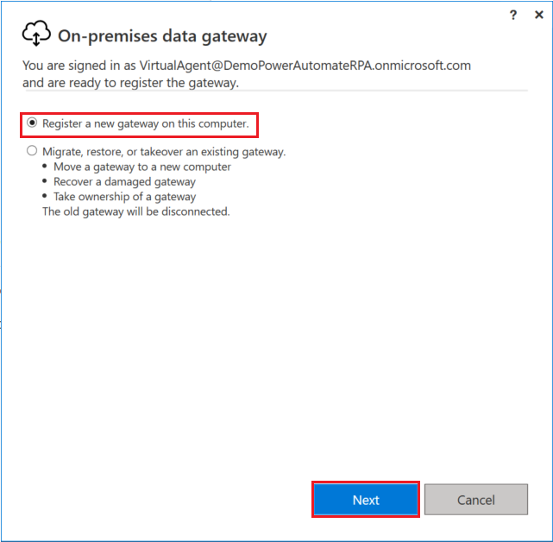
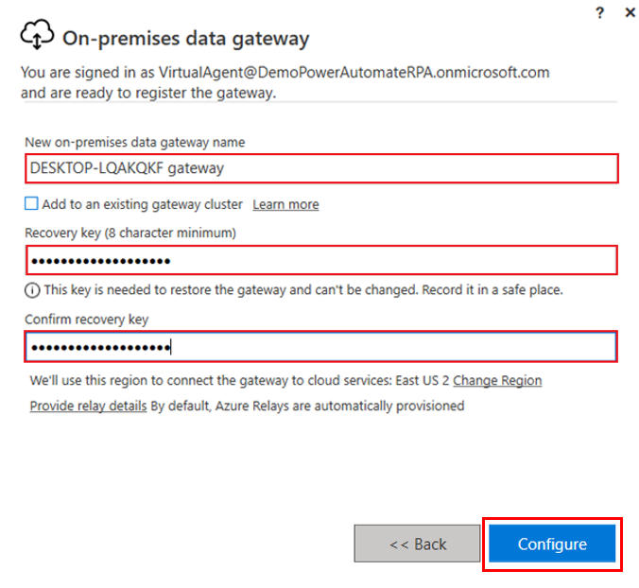
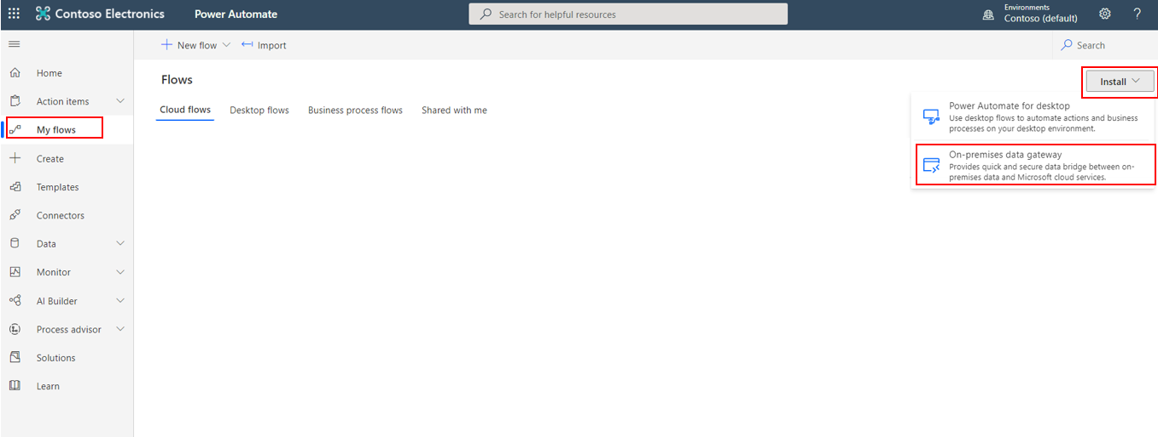
Create a gateway connection
Go to Power Automate and select My flows > Install > On-premises data gateway.
After completing the installation, enter your email address to sign in. Next, select the Register a new gateway on this computer option and then select Next.
Choose a name for your gateway. Next, choose a recovery key. Select Configure.

Slide 31
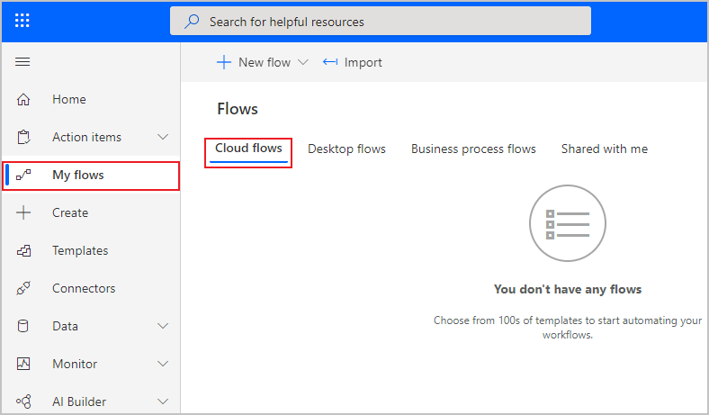
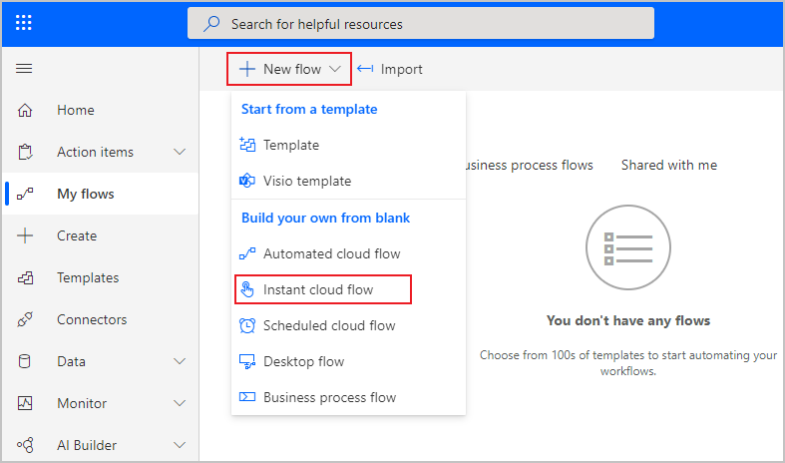
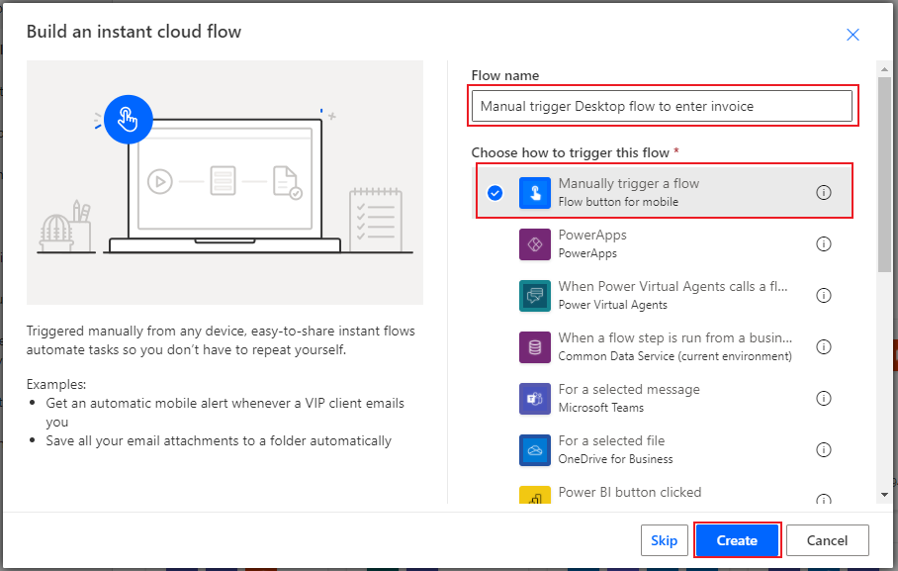
Create a new cloud flow(1/2)
To begin creating your cloud flow, open Power Automate and select My flows > Cloud flows.
Next, select New flow > Instant cloud flow.
Name your flow. The screenshot shows the name as "Manual trigger Desktop flow to enter invoice." Select the Manually trigger a flow option and then select Create.

Slide 32
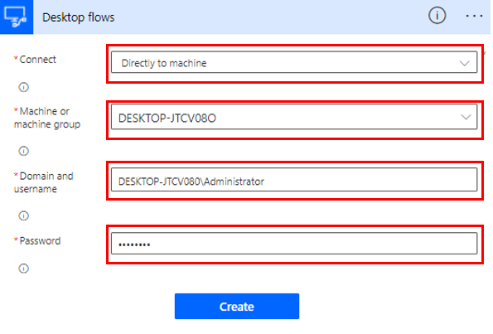
Create a new cloud flow(2/2)
When the screen changes to the flow builder, select New step and then search for and select Run a flow built with Power Automate for desktop.
In the Gateway name drop-down menu, select the gateway that you defined in the previous unit.
Several lines of code will appear. Separate the user domain and the username with a backslash (), as shown in the following screenshot. Select Create, as shown on the right.

Slide 33
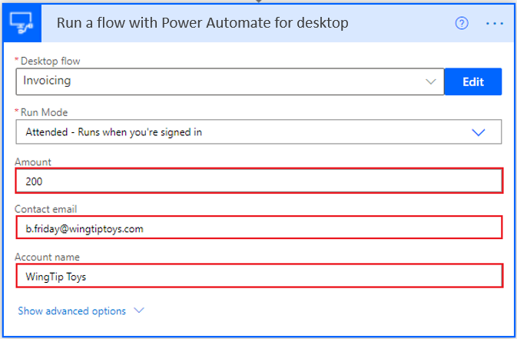
Connect your cloud and desktop flows
Several steps to connect your cloud and desktop flows:
From the Desktop flow drop-down menu, select the name of your desired flow, and then in the Run Mode drop-down menu, select Attended - Runs when you're signed in.
The following screenshot shows that the invoice flow requests an Amount, a Contact email, and an Account name to feed into the Contoso Invoicing app.

Slide 34
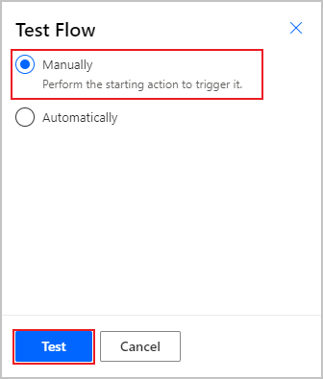
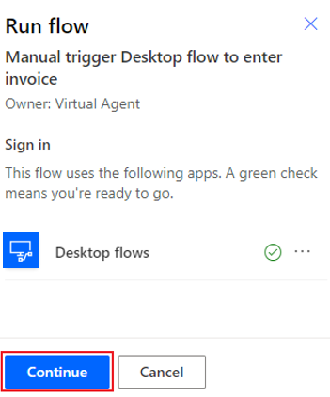
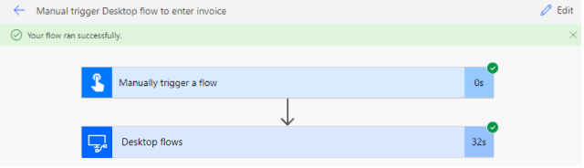
Test your new connection
Select Test in the upper-right corner of the screen, select the Manually option, and then select Test.
After a moment, a green checkmark should appear by your flow to indicate that it's ready for testing. Select Continue.
Select Run flow and Done to watch your flow at work. When testing is complete, the following screen will indicate that your flow ran successfully.

Slide 35
Check your knowledge
How is the recovery key for a gateway generated?
Is it correct that you should not use the keyboard and mouse while desktop flows are running?
What is the bridge that allows you to connect desktop and cloud flows?

Slide 36
Summary
After having reviewed this module, you should be able to:
Create a cloud flow.
Configure the on-premises data gateway to enable the cloud flow to run the desktop flow on your device.
Add the desktop flow to the new cloud flow.
Test the new cloud flow.
Notes:
Key takeaways
Three key takeaways from this module are:
Desktop flows run on a desktop and can access legacy applications.
Cloud flows run in the cloud and can access online services and information.
Defining a gateway allows you to combine cloud and desktop flows to automate any process completely.

Slide 37
Lesson 5:Use AI Builder to process invoice forms in Power Automate

Slide 38
Introduction
In this module, you will:
Build a new AI model for form processing.
Train the new AI model to process Contoso Invoice forms.
Integrate the new AI model into an existing cloud flow.
Test the updated cloud flow and associated AI Builder-based predictions.

Slide 39
Solution setup in Power Automate
Definition of solution setup in Power Automate:
The solution includes a desktop flow that is built into Microsoft Power Automate for desktop to perform actions in an invoicing application.

Slide 40
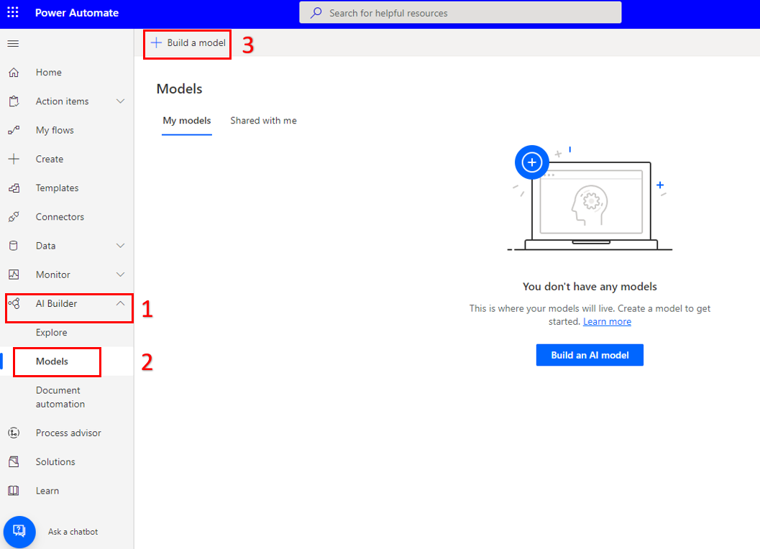
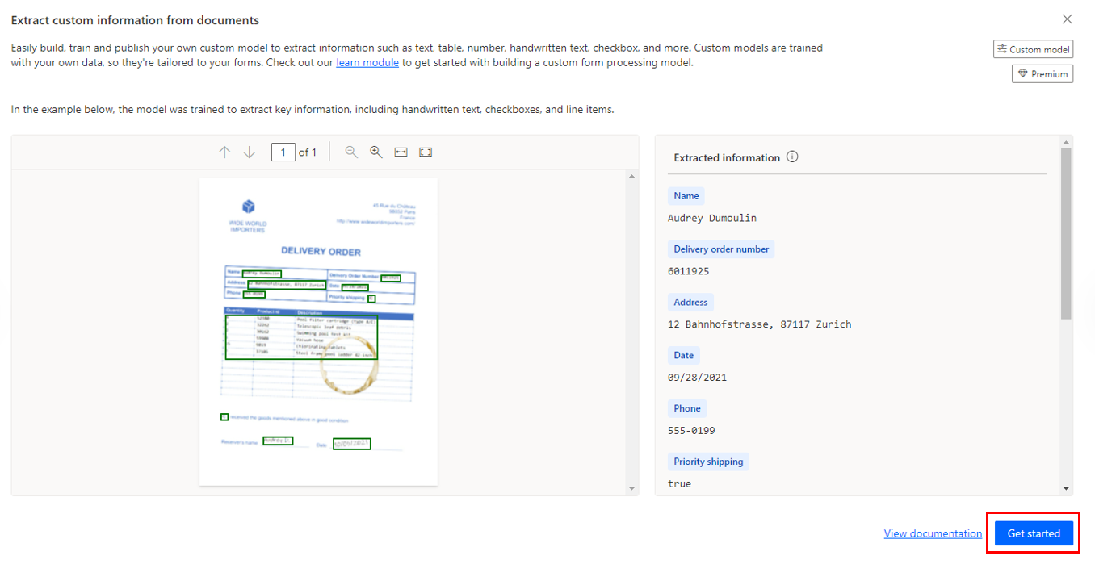
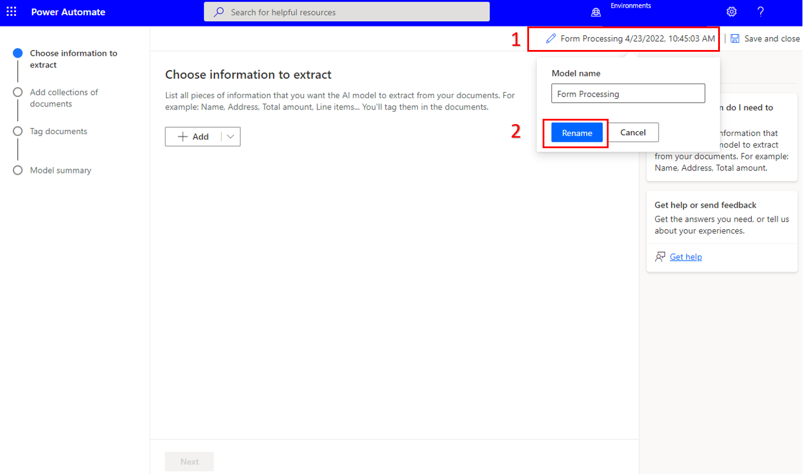
Create a form processing flow
Begin in Power Automate and select AI Builder from the vertical menu and then select Models. Then select + Build a model.
This module uses the Form Processing model, which reads information from documents to extract pertinent details. Choose the appropriate model to continue. Select Get started.
A new screen will appear, which will demonstrate the process of creating and training your model. Select the pencil to rename the form.

Slide 41
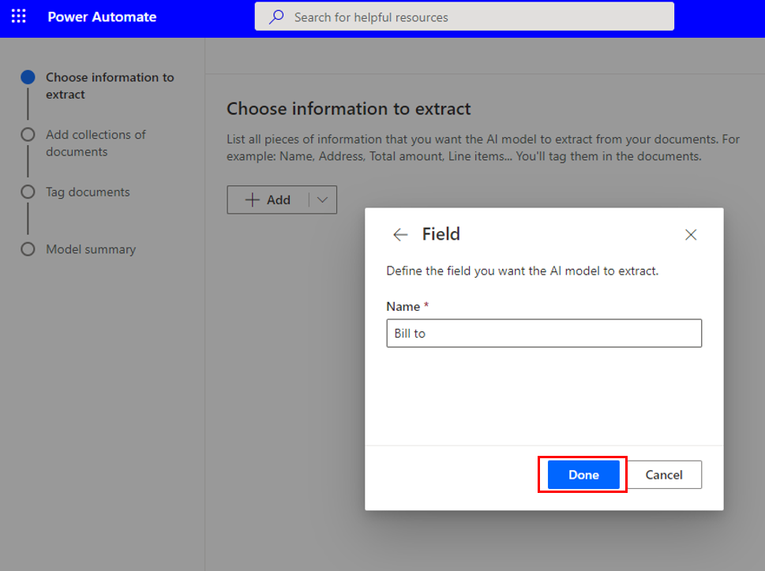
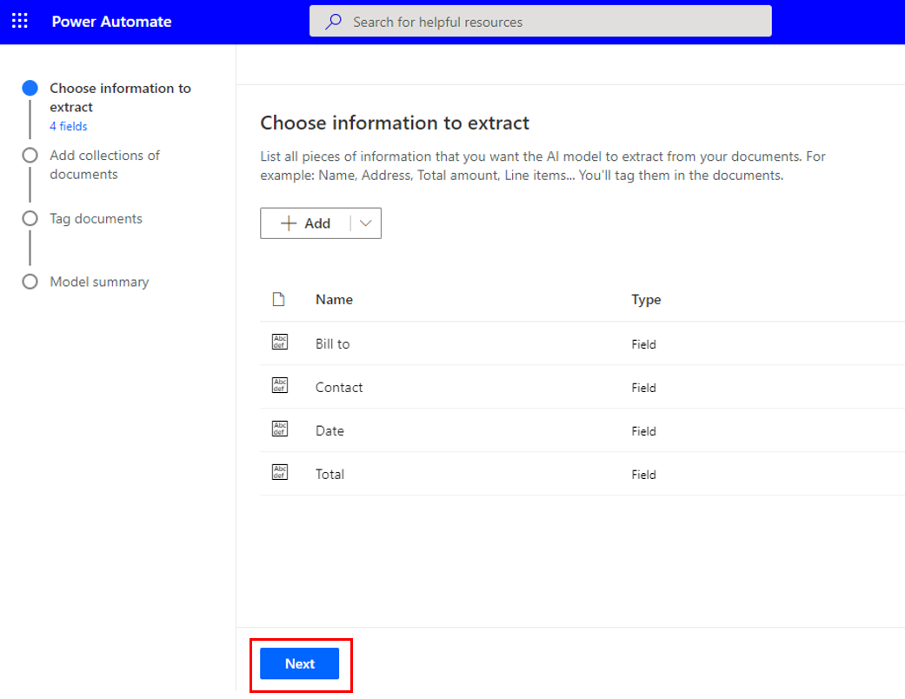
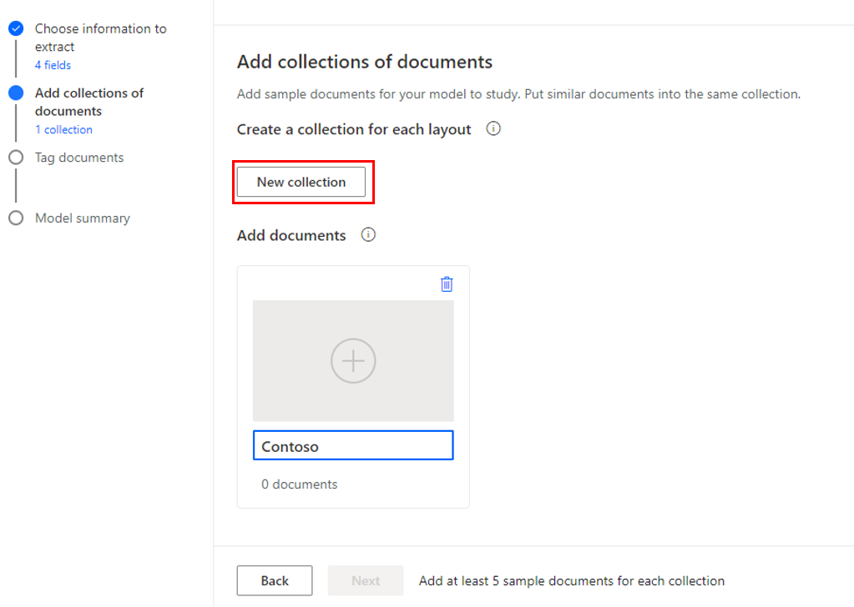
Add fields and collections of documents(1/2)
To add fields, click on the drop-down arrow next to + Add and select Field, enter the field name in the provided text box and click Done. The following screenshot shows the Bill to field. Follow the same process for Contact, Date, and Total.
Select Next to continue.
Next, you'll add collections of documents for your model to study. To add a new collection, select New collection. To rename the newly created collection, double-click the automated collection name.

Slide 42
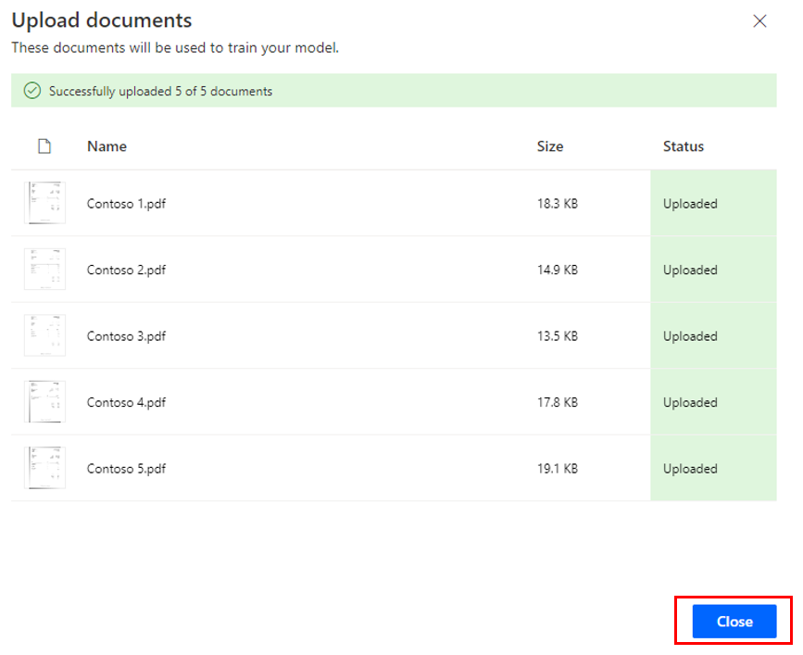
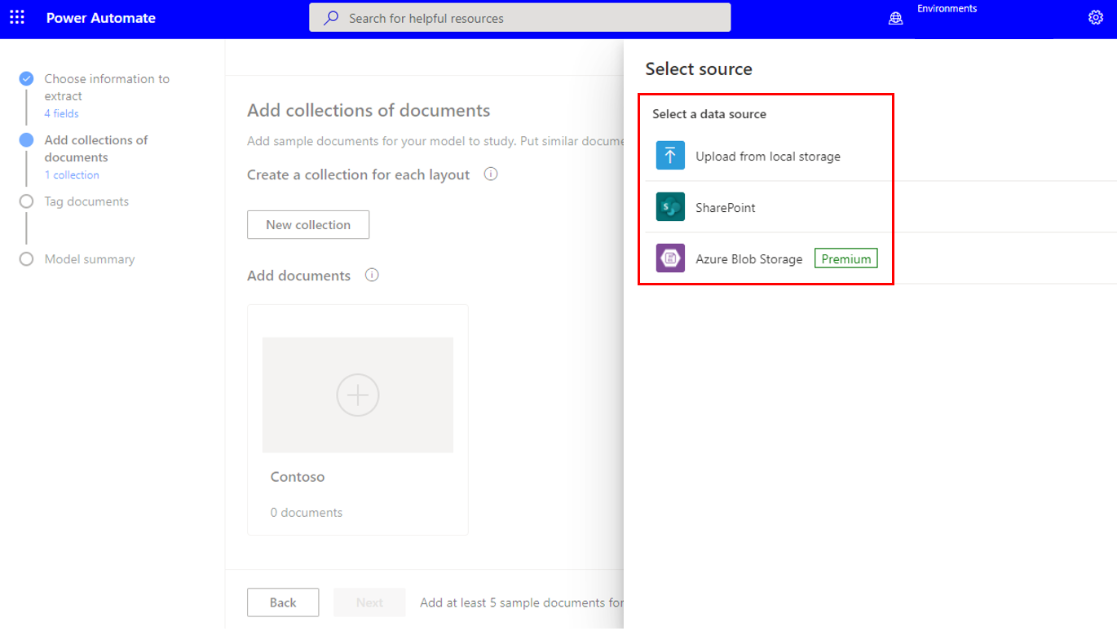
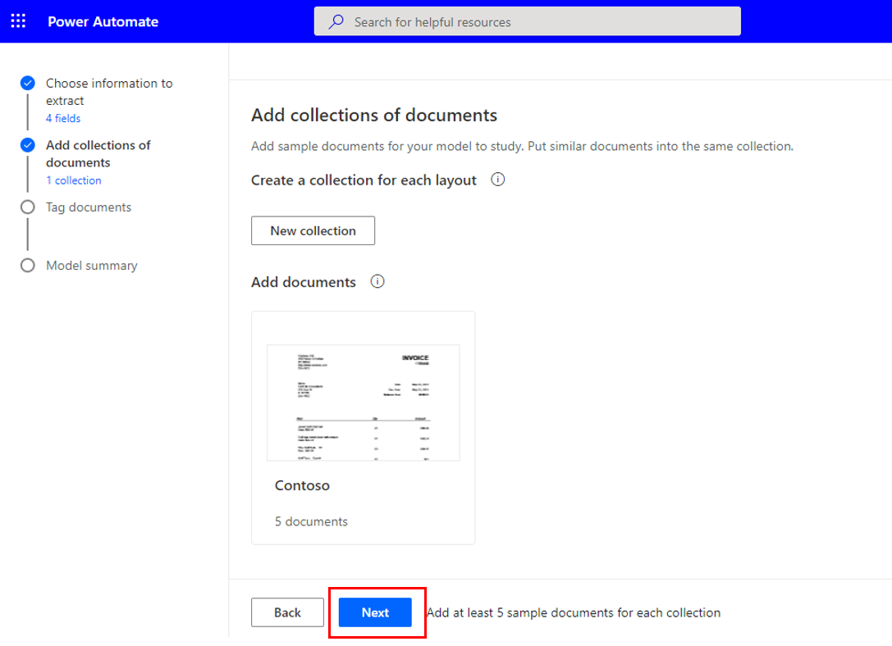
Add fields and collections of documents(2/2)
For this example, the collection has been renamed to Contoso and five invoice documents have been added, as shown in the following image. To add documents, select the plus sign (+), select Add documents, and then select your desired data source.
Select the documents that you want. An upload screen will appear, showing the documents that you've chosen. Select Upload documents, and a screen will display the status of each document. When the upload is complete, select Close.
Now that you've completed your collection and have added your fields, you're ready to analyze and train your model. Simply click Next.

Slide 43
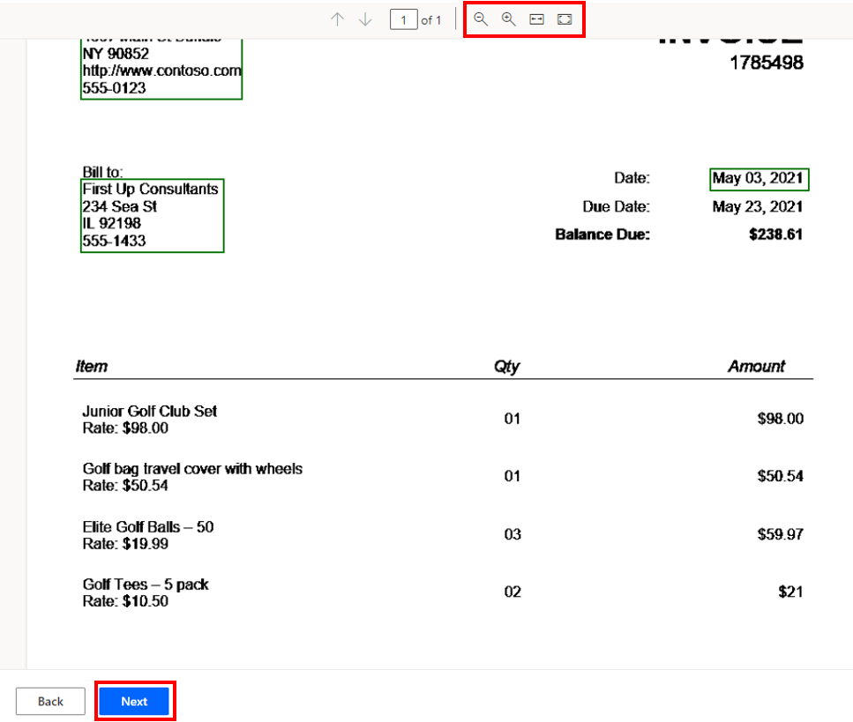
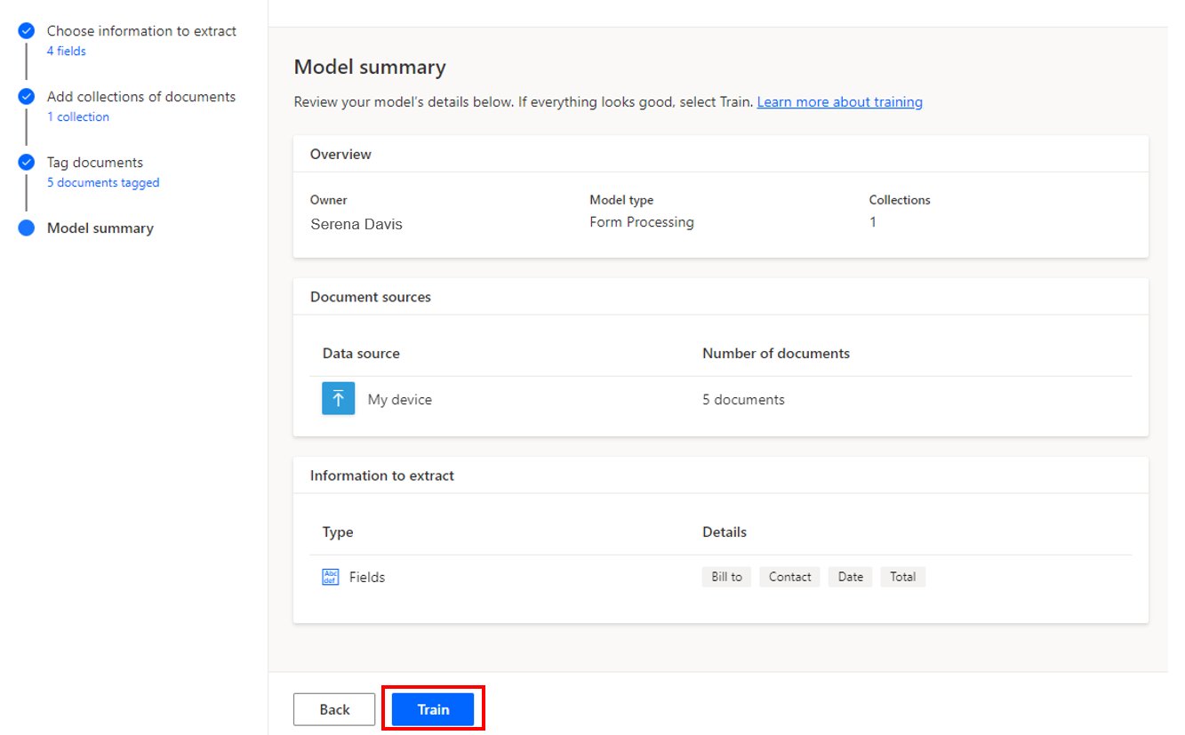
Analyze and train a model
When your collections are complete and all documents are uploaded, select Next to prompt Power Automate to analyze your documents.
When the analysis is complete, your documents will appear organized by collection. After you've identified all necessary fields, you can select the next document. When you've finished identifying the values for every field on every document, select Next.
Select Train to start training the model. This process might take a few minutes. When the process is done, select Go to Details page and select Publish on the following screen.

Slide 44
Integrate the model into a cloud flow(1/2)
How to integrate the model into a cloud flow:
To create it, select Solutions and then + New solution.
Populate the fields as shown below and then click on Create.
Select the new Solution you have just created.
First, click on All (0) then +New. In Automate, select Cloud flow and then select Automated.
Type Predict Outlook email as the flow name. Then search for Outlook and select When a new email arrives (V3). Click Create.
Click on Show advanced options and for Include Attachments and Only with Attachments select Yes.
Select + New step and then search for and select Predict under AI Builder.
Select the model that you want to use, For the document type, search for and select Attachments Content-Type in the Dynamic content menu.

Slide 45
Integrate the model into a cloud flow(2/2)
How to integrate the model into a cloud flow:
You might need to open the Predict action again to specify the Attachment Content dynamic content for the document. Select Save.
While inside the Apply to each action, select Add an action. Search for and add the Send an email (V2) action.
Use Thanks for sending the invoice for the Subject.
Select Test in the upper-right corner of the screen, select the Manually option, and then select Save & Test.
Send yourself an email with an attachment.

Slide 46
Check your knowledge
How many documents are needed to train the form processor?
What does a collection hold in the form processor?
What does the "Apply to each" action do in the created cloud flow?

Slide 47
Summary
After having reviewed this module, you should be able to:
Build a new AI model for form processing.
Train the new AI model to process Contoso Invoice forms.
Integrate the new AI model into an existing cloud flow.
Test the updated cloud flow and associated AI Builder-based predictions.
Notes:
Key takeaways
Three key takeaways from this module are:
Customizing and incorporating AI models into your process automation is simple.
Collections allow you to use up to 100 layouts for form process models.
Using the dynamic content from AI models allows flows to perform actions with data.

Slide 48
Lesson 6:Use the Teams connector in Power Automate

Slide 49
Introduction
In this module, you will:
Integrate a Teams-based approval model and the associated conditional logic into an existing cloud flow.
Integrate the desktop flow for entering the invoice information into the approval process.
Integrate Microsoft Outlook-based approval and rejection notifications into the invoice process.
Test the end-to-end invoice processing cloud flow.

Slide 50
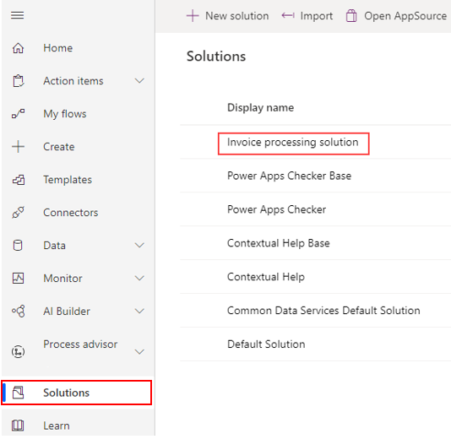
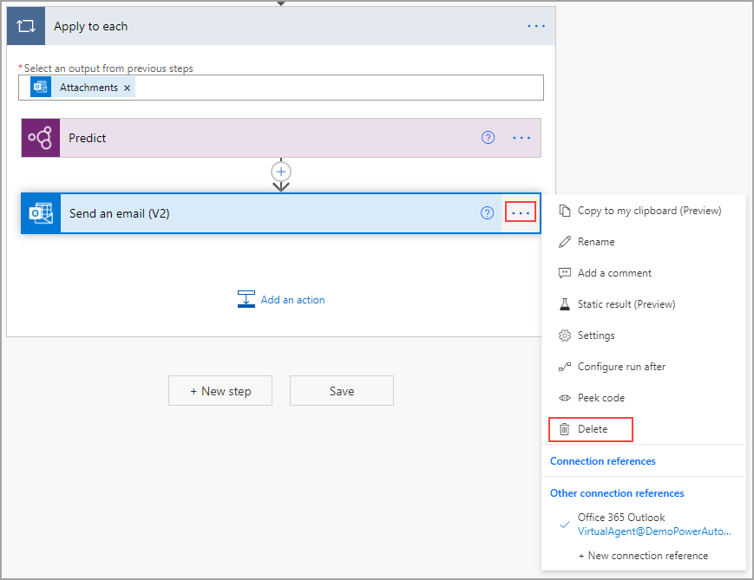
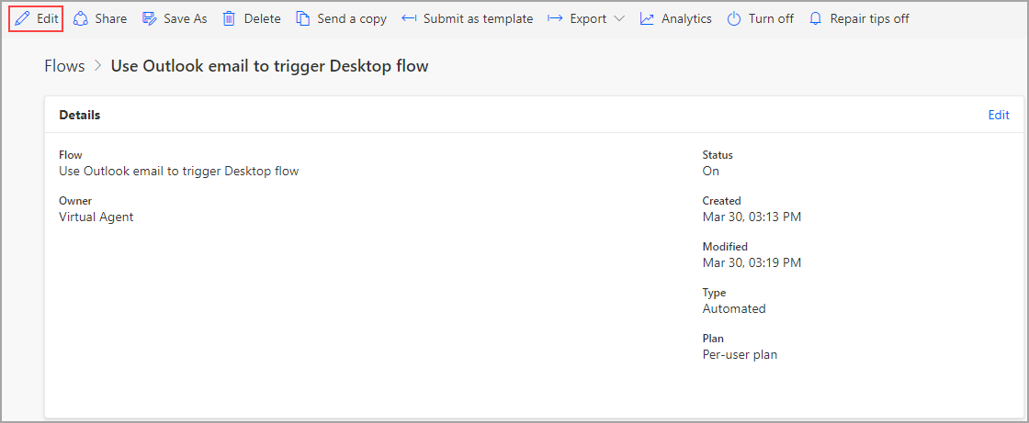
Work from an existing solution in Power Automate
Start in Power Automate, select Solutions, and then select the name of your solution.
Select the flow in which you want to use the AI model. If you're following from previous models, the name of the flow is Use Outlook email to trigger Desktop flows. Select Edit.
For now, you can delete the Send an email (V2) action by selecting the ellipses and then selecting Delete.

Slide 51
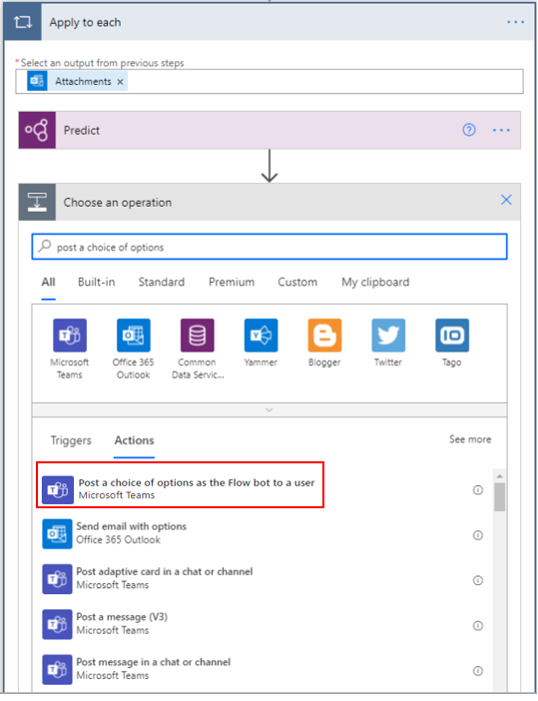
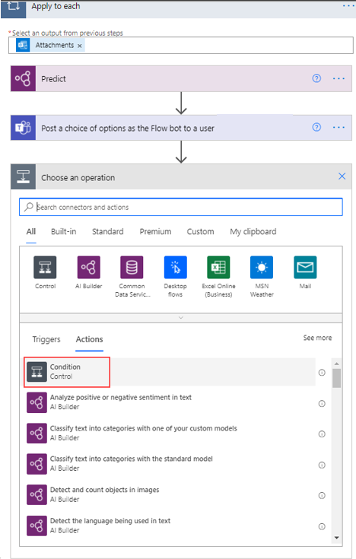
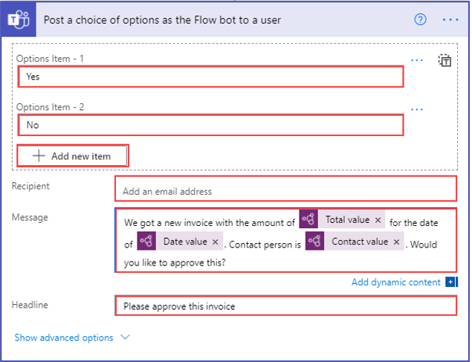
Create an approval solution(1/2)
To add the actions that will post to Teams, select Add an action. Search for and select the Post a choice of options as the Flow bot to a user option.
In the Options Item - 1 field, enter Yes. Select Add new item and then enter No in the Options Item - 2 field. Add your email address in the Recipient field. The Headline field should read: Please approve this invoice.
Now that you've posted in Teams, you will want to act on the response. To accomplish this task, select Add an action in the Apply to each screen. Search for and select Condition.

Slide 52
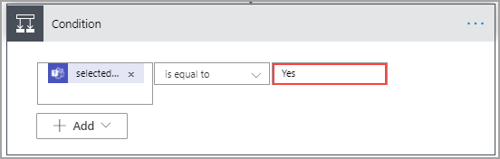
Create an approval solution(2/2)
The final steps to create an approval solution:
For the first value, select selectedOption from the Dynamic content menu.
Ensure that the operator field is set to is equal to and then enter Yes for the second value. As shown on the right.

Slide 53
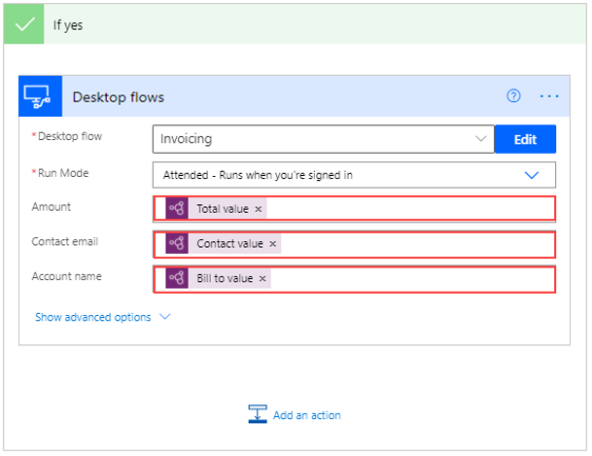
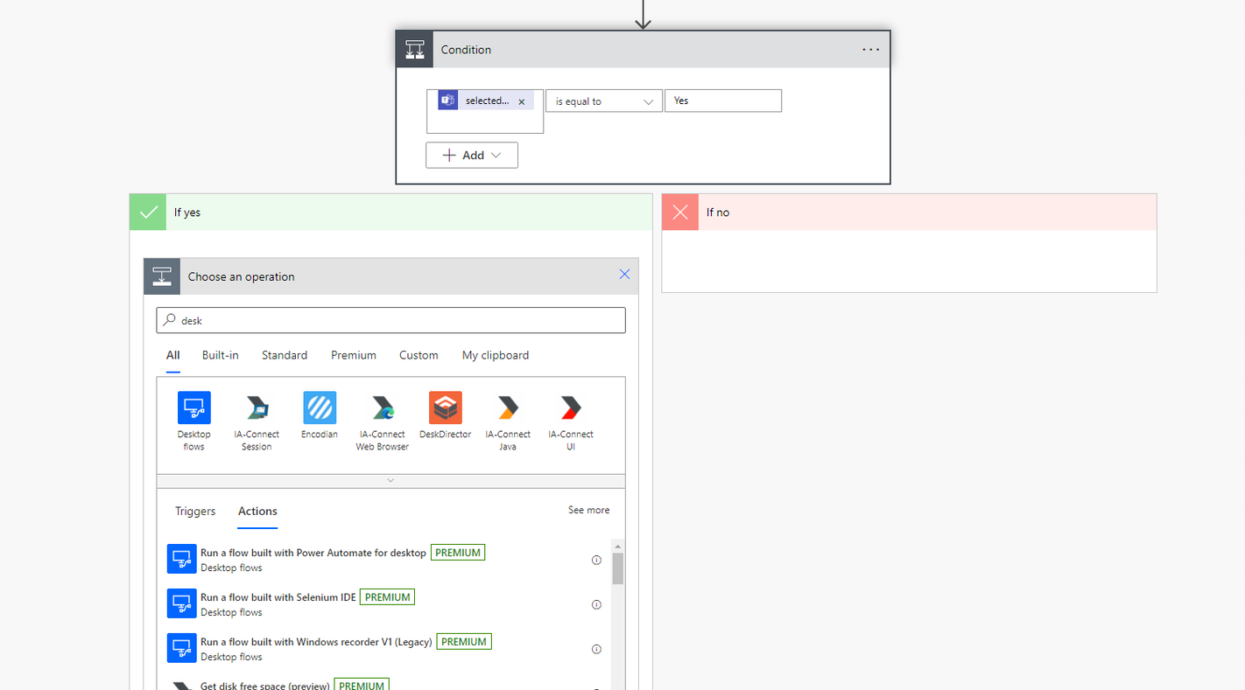
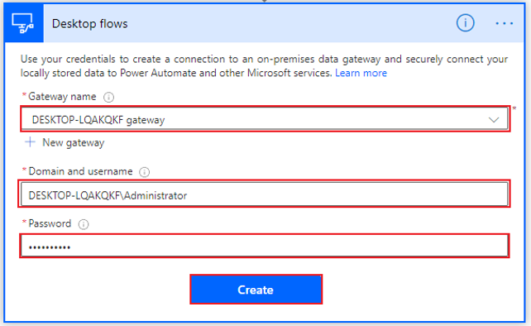
Integrate with an existing desktop flow
The first step is to select Add an action under the If yes branch and then search for and select the Run a flow built with Power Automate for desktop option.
Several lines of code will appear. Separate the user domain and the username by a backslash (), as shown in the following screenshot. Select Create.
Chose your desktop flow. Notice in the following screenshot that the invoice flow is requesting an Amount, a Contact email, and an Account name to feed into the Contoso Invoicing app.

Slide 54
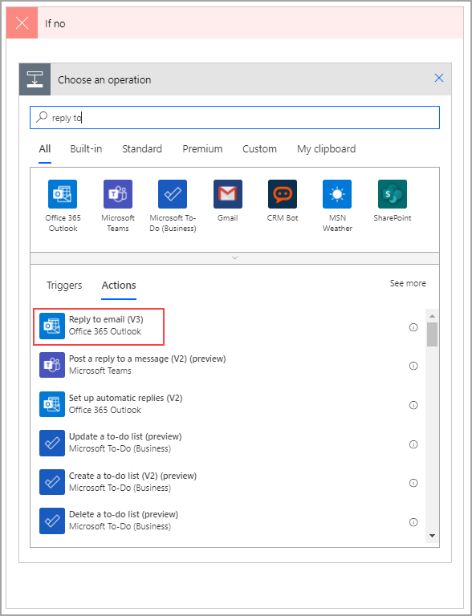
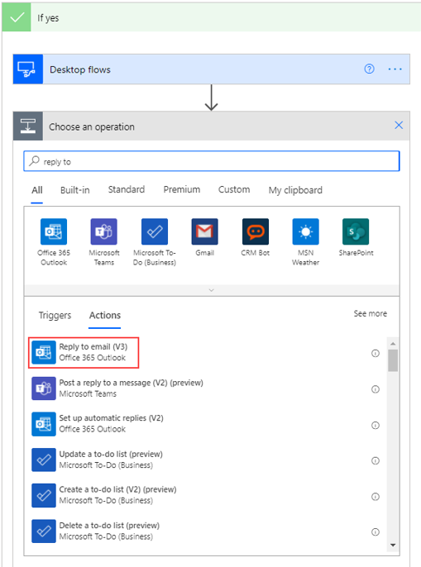
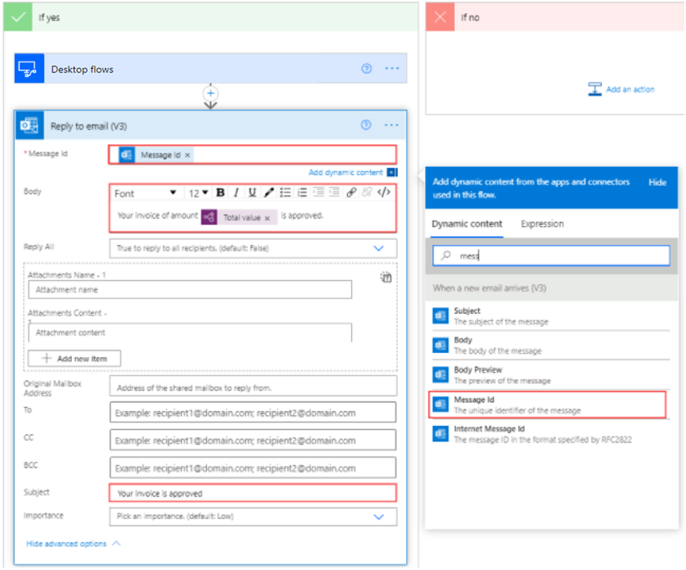
Build in communication with Outlook
To begin, select Add an action under the If yes branch and then search for and select Reply to email (V3).
For the first field, find the Message ID of the original email in the Dynamic content menu. The body will be a combination of text and dynamic content.
Now, you have the approval email and only need to add the rejection email. To do so, ensure that you are under the If no branch and then select Add an action. Search for and select Reply to email (V3).

Slide 55
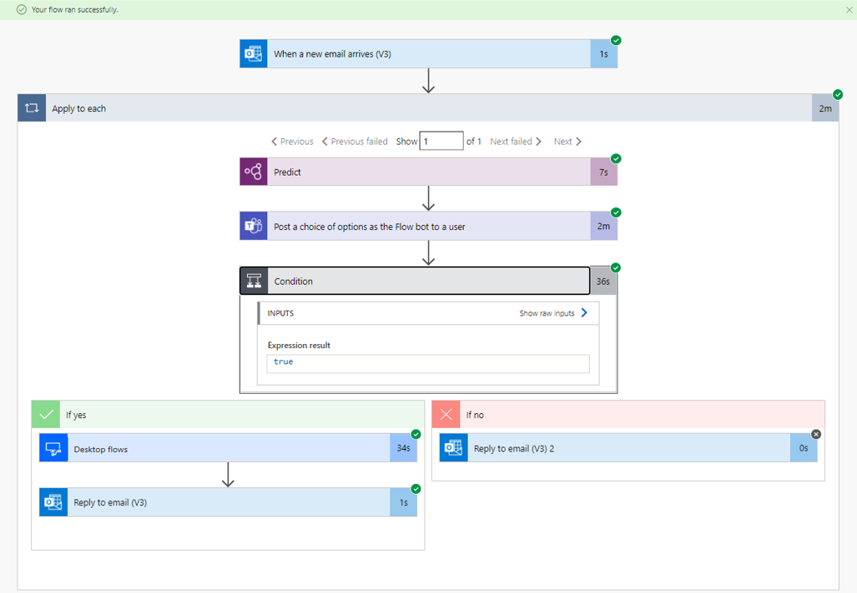
Test and run a flow
The steps to test and run a flow:
Select Test in the upper-right corner of the screen, select the Manually option, and then select Save & Test.
Open the Power Automate for desktop application. Send yourself an email with an attachment. When the Teams message appears, select Yes.
Avoid interacting with your mouse or keyboard while the flow continues running.
When testing is complete, the following message will appear, indicating that your flow ran successfully, as shown on the right.

Slide 56
Check your knowledge
In which case should you not use dynamic content?
To which programs can cloud flows connect?
Which actions occur outside of the Apply to each control?

Slide 57
Summary
After having reviewed this module, you should be able to:
Integrate a Teams-based approval model and the associated conditional logic into an existing cloud flow.
Integrate the desktop flow for entering the invoice information into the approval process.
Integrate Outlook-based approval/rejection notifications into the invoice process.
Test the end-to-end invoice processing cloud flow.
Notes:
Key takeaways
Three key takeaways for this module are:
Dynamic content enables you to use information from previous steps in a flow.
Power Automate has hundreds of connectors that you can use to design a truly robust RPA.
Solutions allow you to integrate various programs, such as Teams and Outlook, with legacy desktop applications.

Slide 58
Lesson 7:Run a Power Automate for desktop flow in unattended mode

Slide 59
Introduction
In this module, you will:
Run a basic desktop flow in unattended mode.
Run a desktop flow and cloud flow scenario in unattended mode.
Learn best practices and setup for unattended desktop flows.

Slide 60
Set up an unattended desktop flow
For an unattended desktop flow to run smoothly, you need to have:
All users completely signed out.
A locked screen (enabling the flow to run without users seeing the actions that are performed).
A gateway with the user sign-in information to the desktop.

Slide 61
Create a new cloud flow that calls an existing flow in unattended mode(1/2)
To begin creating your cloud flow, open Power Automate and select My flows and then Cloud flows.
Next, select New flow > Instant cloud flow.
Name your flow. The following screenshot shows the example name as Manual trigger Desktop flow to enter invoice. Select the Manually trigger a flow option and then select Create.

Slide 62
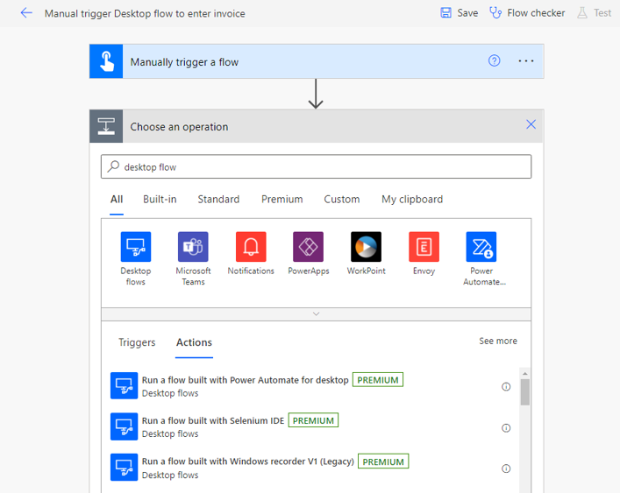
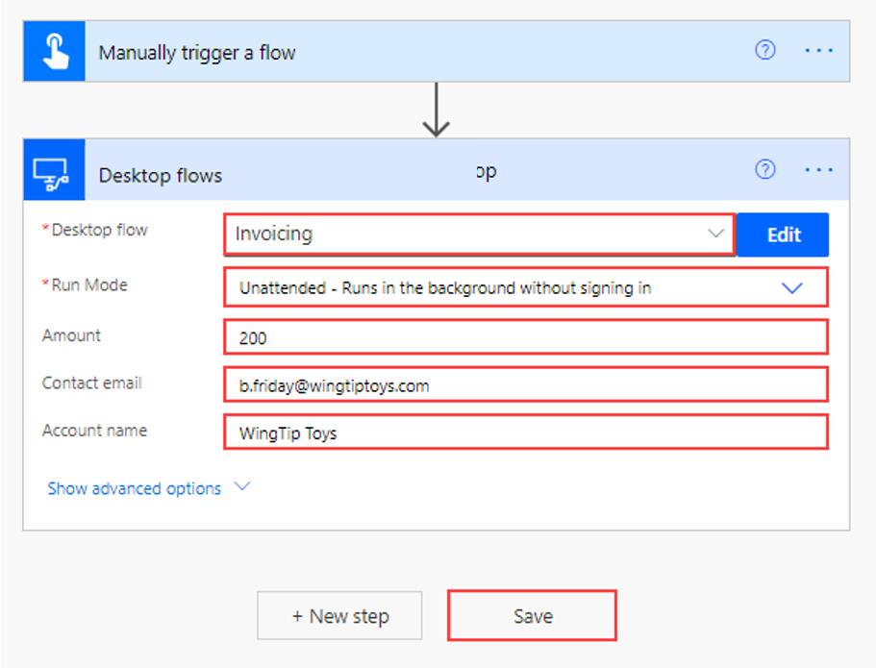
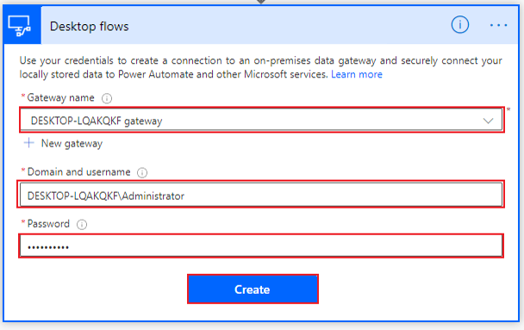
Create a new cloud flow that calls an existing flow in unattended mode(2/2)
When the screen changes to the flow builder, select New step and then search for and select Run a flow built with Power Automate desktop flow.
Several lines of code will appear. Separate the user domain and the username with a backslash (), as shown in the following screenshot. Select Create.
After you've selected your desktop flow, requested input variables will be added for you to fill in. Select Save.

Slide 63
Perform a test run
Several points to be paid attention to when you perform a test run:
It's important that you go to your desktop app and note its current state.
If you are signed in to and using the machine that will run the desktop flow, make sure that you save your work, close out of all programs, and then sign out.
If you are running the desktop flow on a virtual machine, ensure that the virtual machine is still running.
After the flow has completed, sign in to your device again and ensure that the unattended desktop flow ran properly.

Slide 64
Best practices
You can use any of the following strategies:
Plan your unattended desktop flows to run at different times of the day, spreading your load over time.
Create clusters of machines that can run unattended desktop flows with identical configurations in parallel.
Create multiple desktop flows, where each uses a separate connection to target different machines.

Slide 65
Check your knowledge
Which of the following would make running an unattended desktop flow simpler or more efficient?
Which of the following is true regarding unattended desktop flows?
Through which of the following options can a cloud flow connect to a desktop flow?

Slide 66
Summary
After having reviewed this module, you should be able to:
Run a basic desktop flow in unattended mode.
Run a desktop flow and cloud flow scenario in unattended mode.
Strategize by using best practices and set up for unattended desktop flows.
Notes:
Key takeaways
Three key takeaways for this module are:
Unattended desktop flows allow you to automate processes that can run without human oversight.
Follow best practices to avoid overloading your machine or having your flows time out.
Ensure that the device that is running your unattended flow doesn't have signed-in users.
For more information about grouping, see manage machine groups.

Slide 67
Lesson 8:Optimize your business process with process advisor

Slide 68
Introduction
Definition of process advisor:
Process advisor works through Power Automate to record your actions on your desktop to map your process. Then, it will map your process and provide insights on actions that take too long or have too many variations, and then it will give you automation recommendations.

Slide 69
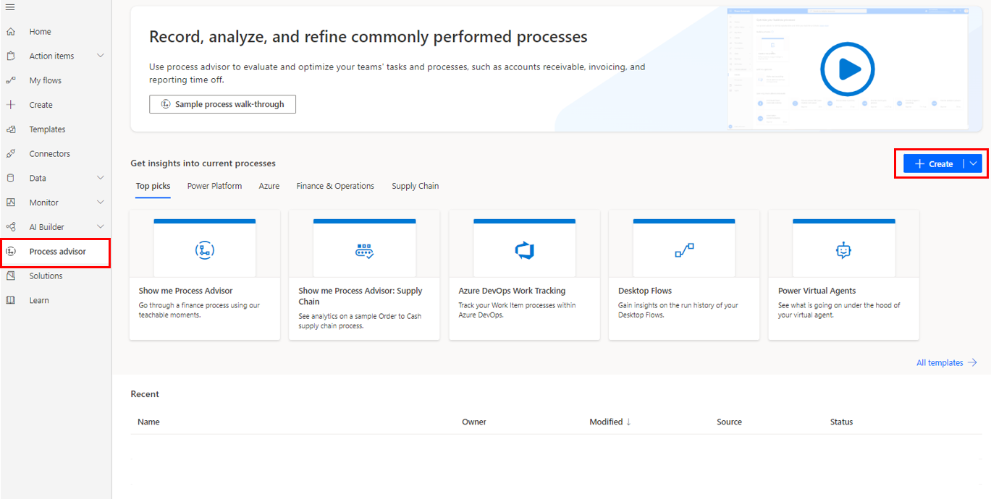
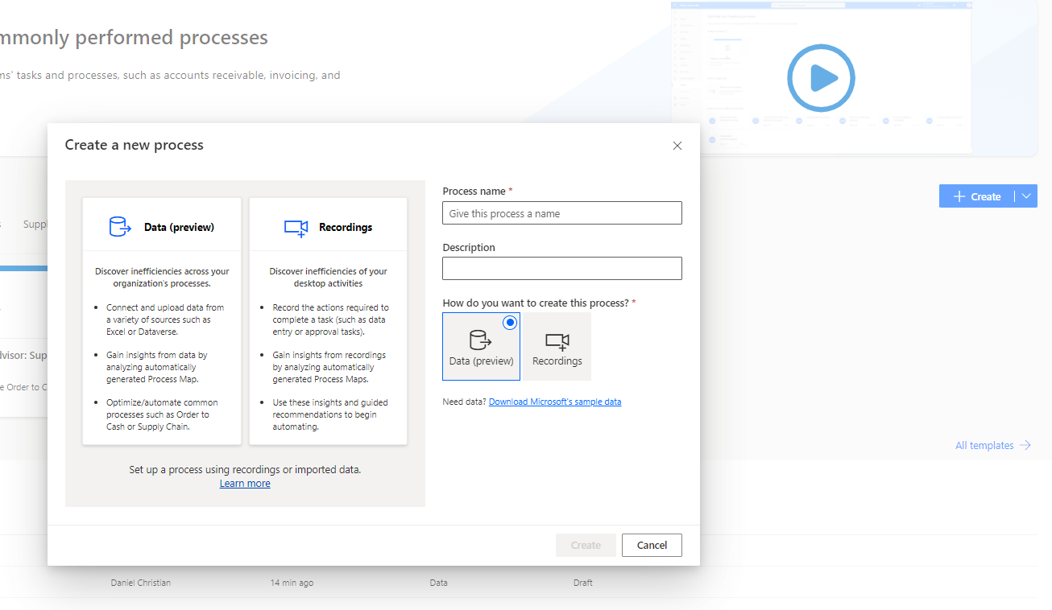

Get familiar with process advisor(1/2)
You can access process advisor through Power Automate by selecting Process advisor on the left navigation pane and then Create on the right side of the screen.
On the process advisor screen, you can create a new process or add recordings to an existing process.
Additionally, you can select a link to download Power Automate for desktop flow and view short instructional videos that describe various tasks in process advisor.

Slide 70

Get familiar with process advisor(2/2)
Selecting a process lets you see the details that are involved, such as:
The various recordings
Who created them
At what time
Their status
Screenshot of process details including recordings.

Slide 71
Create your first recording
Several steps to create your first recording:
To begin recording, you first need to have a process. If you've already created a process, select that process and then select New recording in the upper-left corner of the page.
If you don't have a process yet, select Process advisor > Create > Blank process.
Name your process. Provide a description to help you and your users understand the process that is being analyzed. The Data (preview) process is by default selected. Select Recordings and then click Create.
Next, select Add a recording.
After completing the cleanup items, you'll be ready to begin recording. To begin, select the Start recording button in Power Automate for desktop.
After you've finished your actions, return to the recording window and select Finish.
After you select Finish, your recording will upload.

Slide 72
Edit recordings and group actions
How to edit recordings and group actions:
Recordings have several available statuses. When a recording is being uploaded, it will have a status of In progress. When it's ready for grouping and editing, it will have a status of Not analyzed. Choose a recording with this status to prepare it for analysis by grouping and editing actions.
By selecting individual actions, you can edit the action text or description to eliminate private data or personal information and then delete the screenshot.
To prepare a recording for analysis, you must first group the individual actions into activities, etc.

Slide 73



Analyze recordings and interpret results(1/2)
When your recordings are prepared, go to your process and select Analyze.
In the following pop-up window, select Confirm.
The analytics screen will look similar to the following screenshot.

Slide 74

Analyze recordings and interpret results(2/2)
The preceding image shows many metrics that you need to consider. The first visual is the process map. You can enlarge the process map by selecting the Focus mode icon in the upper-right corner.
The process map breaks down each activity in order. It also shows the average amount of time for each activity and variations in the process.
The other visuals will help to further break down the information in the process map.

Slide 75



Automation recommendations
As shown in the screenshot, these blue icons are recommendations for automation.
Selecting a blue icon will begin a new cloud flow with suggestions for connectors that are grouped by activities based on your process.
Selecting a recommended connector will add the selection to your flow.

Slide 76
Check your knowledge
How many recordings do you need to analyze a process?
What process advisor role does another user need to add recordings to your process?
What is a variant?
What connectors can automation recommendations suggest for improving your business processes and increasing efficiency?

Slide 77
Summary
Benefits of process advisor:
Process advisor can help you understand the different ways that your users are completing a process.
With minimum setup, process advisor will map your process and give you insights on actions that are taking too long or have numerous variations.
By taking advantage of the process advisor capability in Power Automate, you can simplify your business processes and increase efficiency.
Notes:
Key takeaways
Three key takeaways for this module are:
Unattended desktop flows allow you to automate processes that can run without human oversight.
Follow best practices to avoid overloading your machine or having your flows time out.
Ensure that the device that is running your unattended flow doesn't have signed-in users.
For more information about grouping, see manage machine groups.

Slide 78
Closing slide

